Slide 1
YOUTUBE VIDEO DOWNLOADER

Slide 2
ABSTRACT:
You tube Video Downloader is an Web Application to download videos from YouTube.
This provides users to download videos they need in their
devices and watch them offline.

Slide 3
INTRODUCTION:
The You tube downloader project is a Web Application
project.
The object of this project is to download any type of video in a fast and easy way from you tube with quality control in your device.

Slide 4
PROBLEM:
YouTube is very popular video sharing website. Downloading a video from YouTube is a tough job.
Downloading the Downloader and get the video using that or go to any other website with lots of ads and then which fetches the video and saves on your computer.

Slide 5
LANGUAGES USED:
HTML
CSS
BOOTSTRAP
JQUERY

Slide 6
SOURCE CODE:

Slide 7
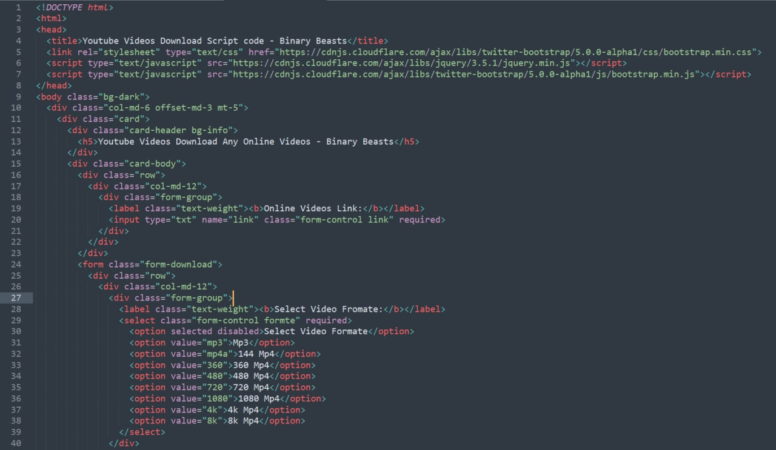

Slide 8
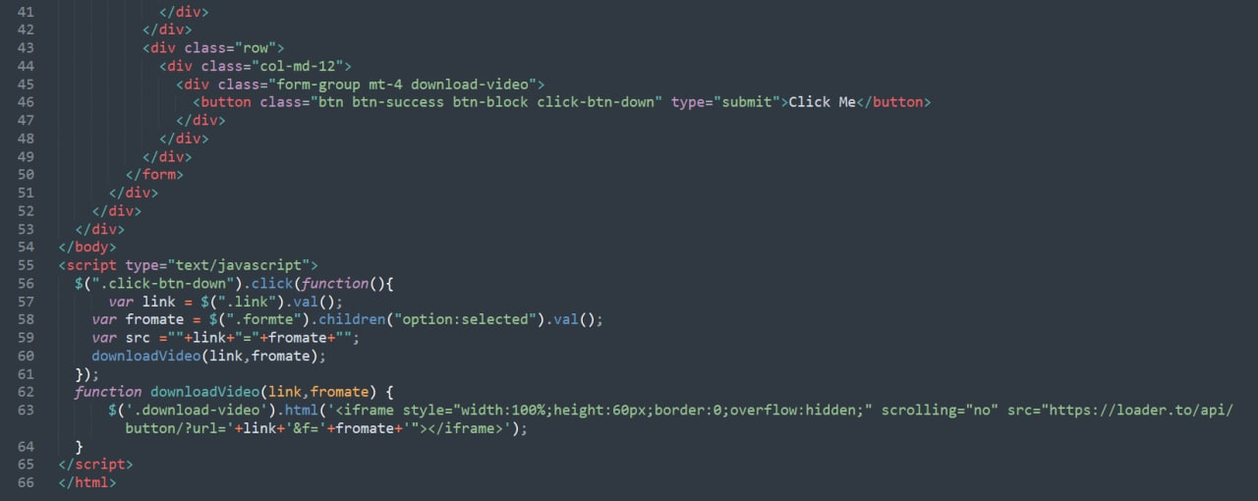

Slide 9
Steps to Develop Python YouTube Downloader:
Project Prerequisites

Slide 10
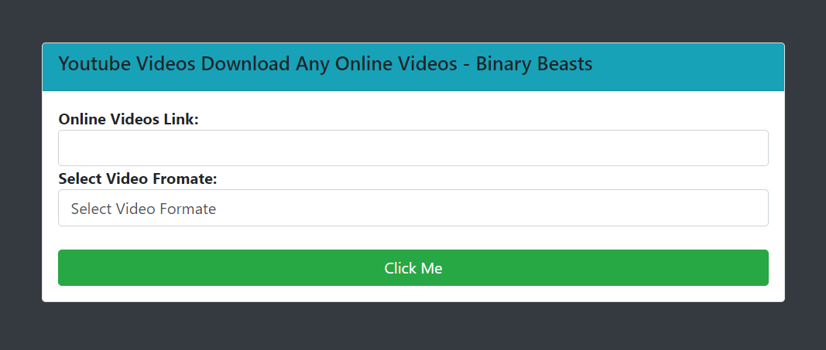

Slide 11
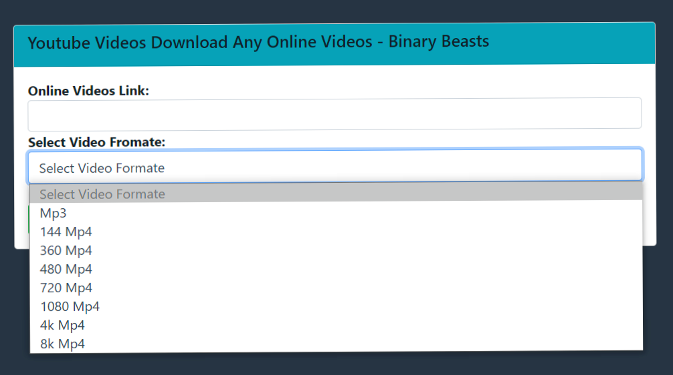

Slide 12
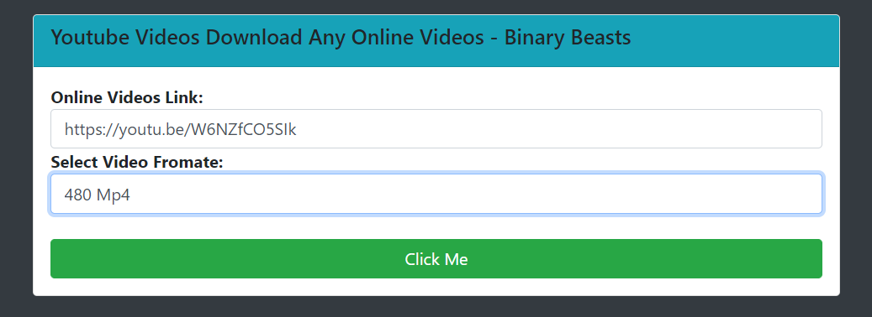

Slide 13
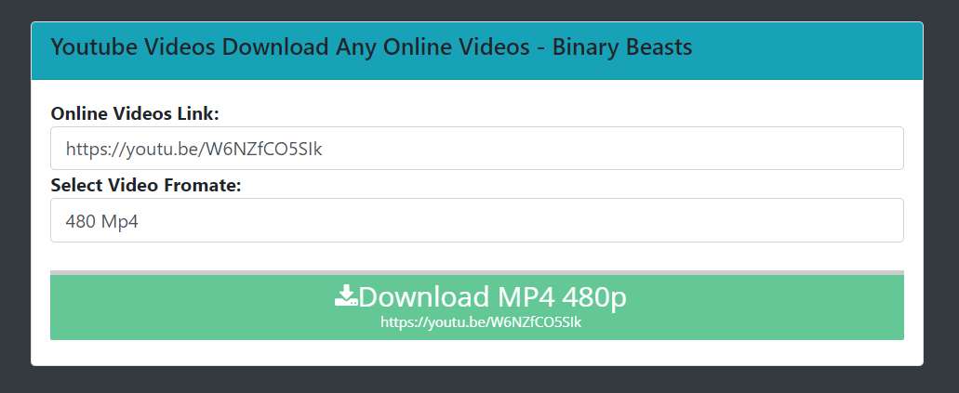

Slide 14
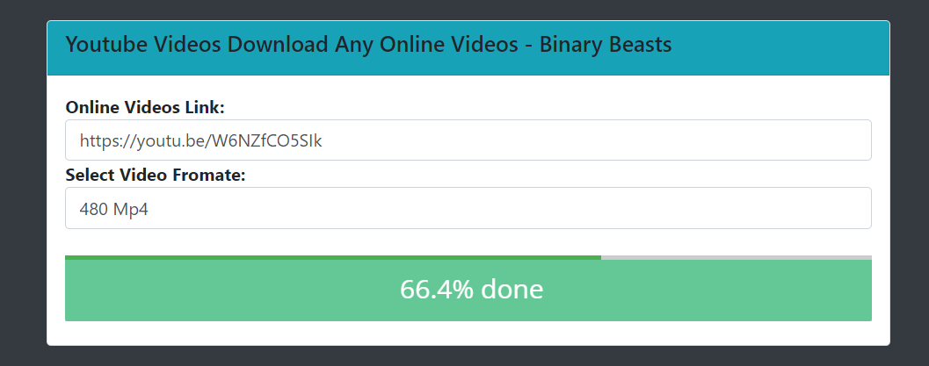

Slide 15
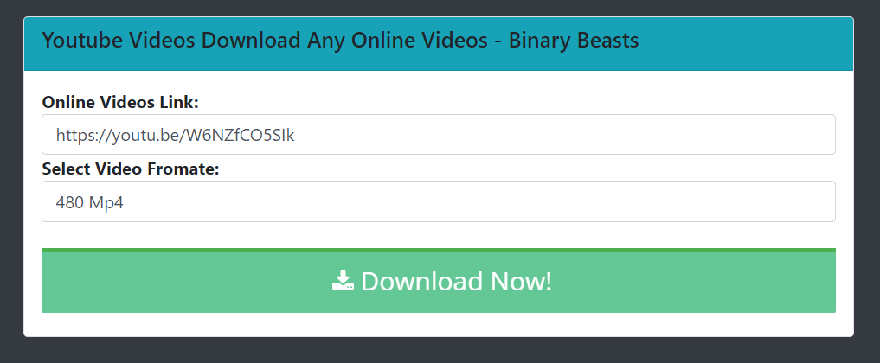

Slide 16
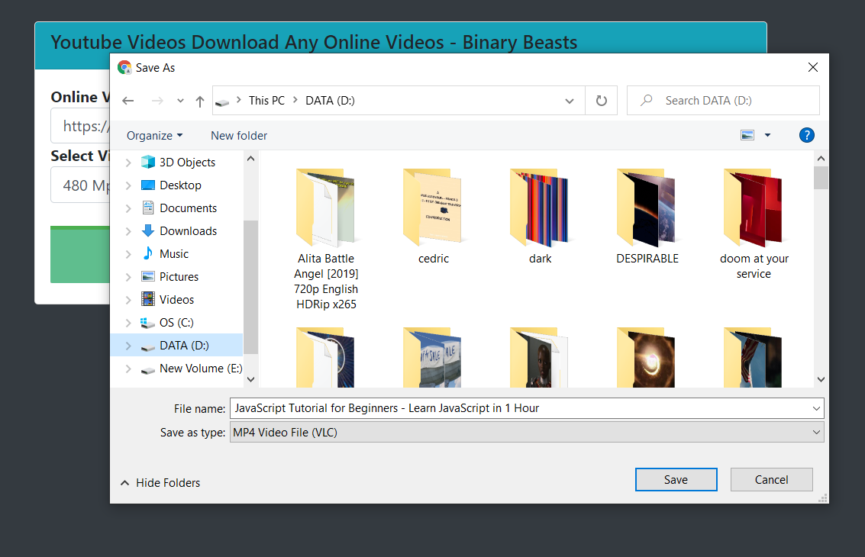

Slide 17
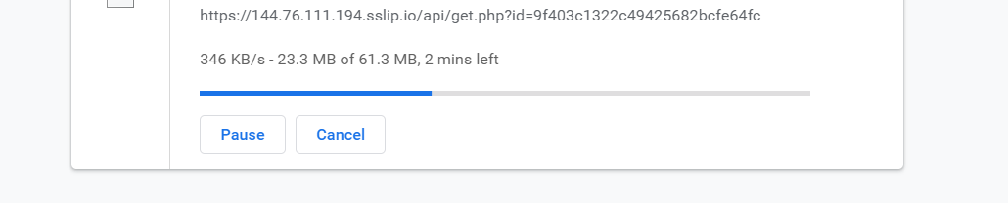

Slide 18
FEATURES: Compare to other websites , our website does not contain any Ads We Introduced Quality control option up to high resolution (also only audio) to download best quality video. Simple, Fast and efficient.

Slide 19
CONCLUSION: With this project, we have successfully developed the you tube video Downloader Web Application using HTML, CSS, BOOTSRATP and JQUERY.

